Slide 1
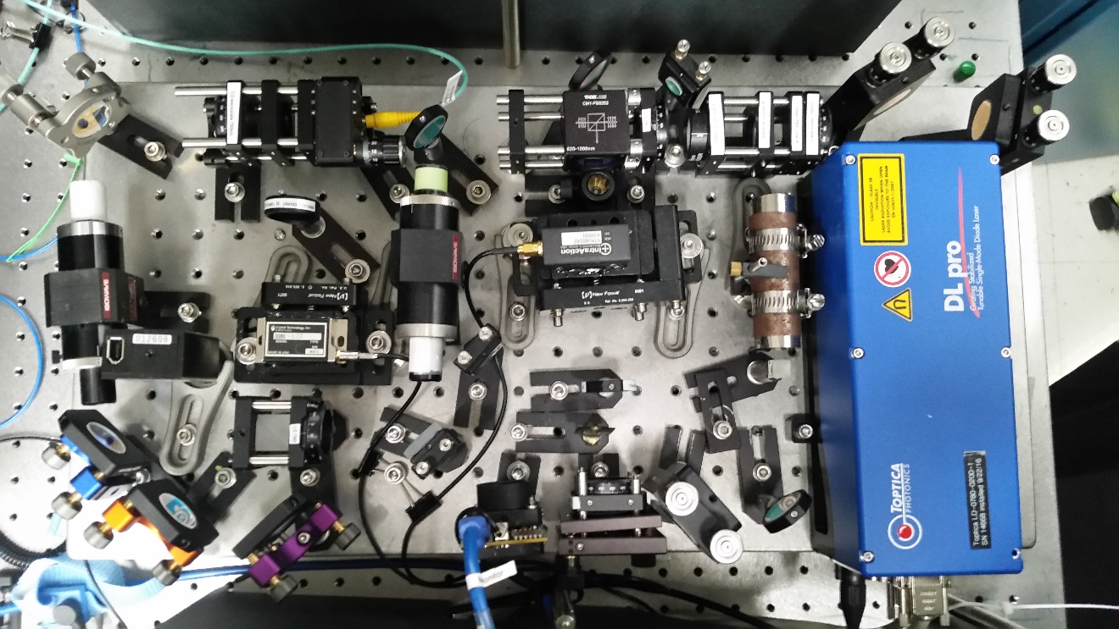
To beat note locks
Rb vapor
Former soliton beam
0th order
1st order
Probe
Pump
Photodetector

Slide 2
New lens:
f = 40 cm
cylindrical
f = 10 cm
f = 15 cm
f = 25 cm
atoms
~12 cm
6.5 cm
10.2 cm
26.15 cm

Slide 3
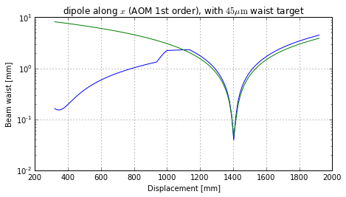
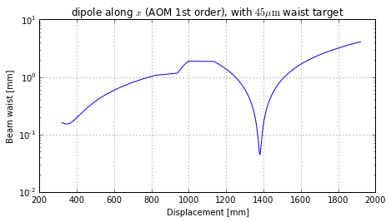
First, as it basically is now (BEC at 1400 mm on the horizontal axis)
(a)
atoms
(b)
atoms

Slide 4
Then with the addition of a 750 mm lens 120 mm from the first lens

Slide 5
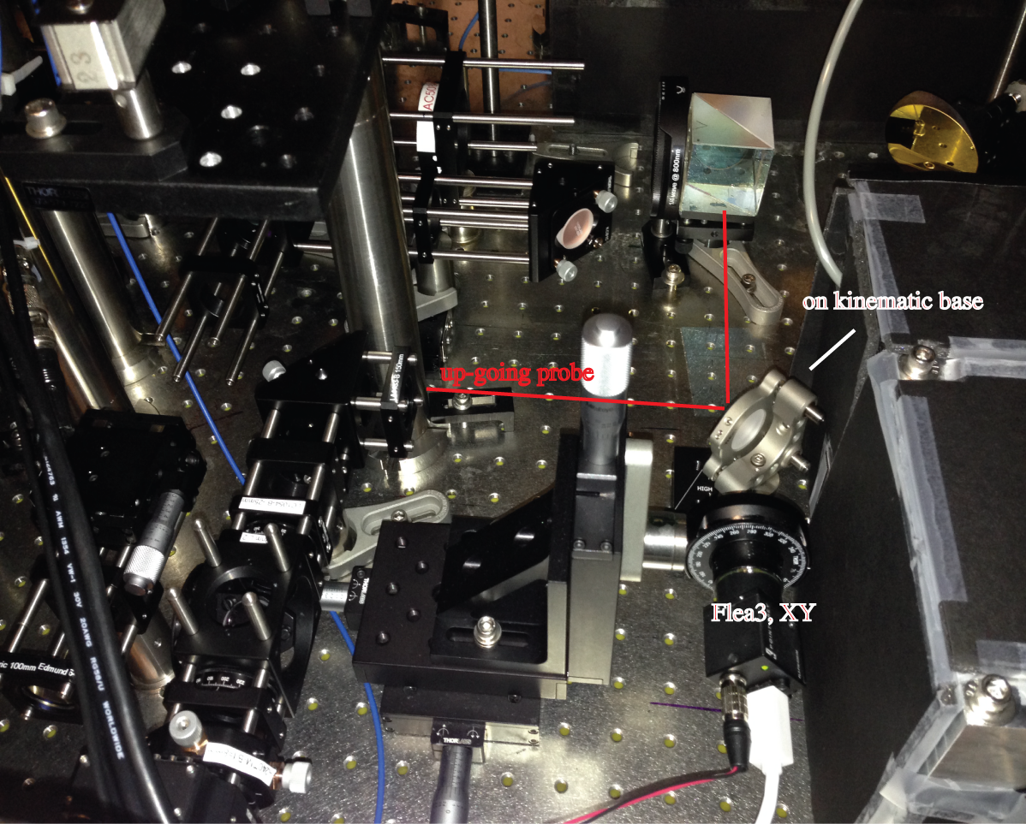

Slide 6
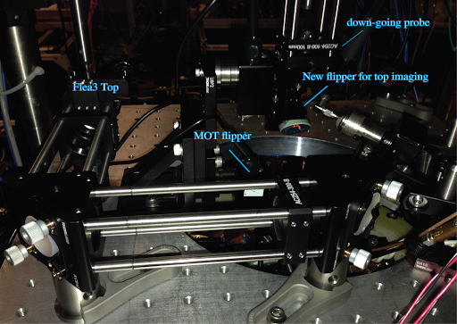

Slide 7
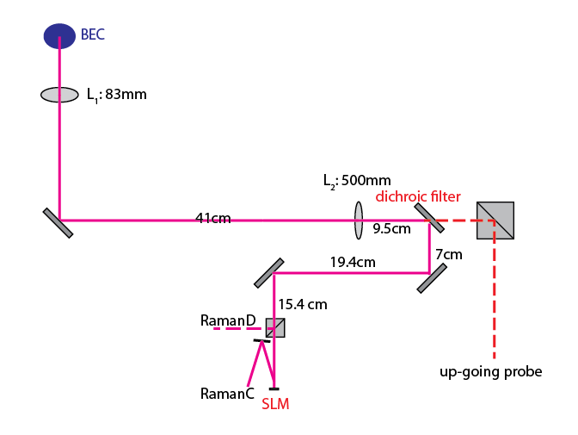
kinematic
base
mirror

Slide 8
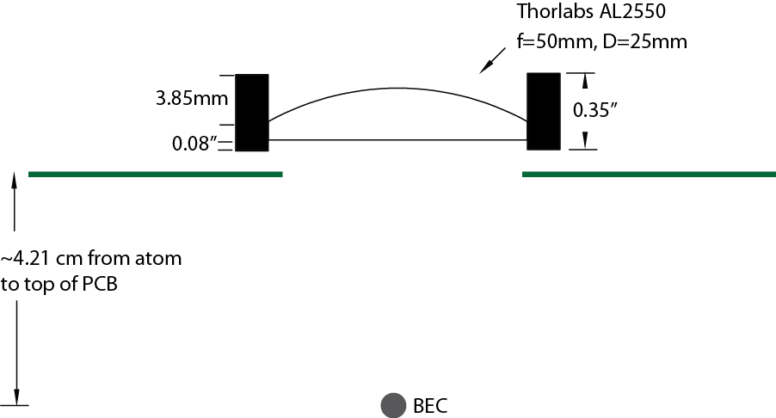

Slide 9
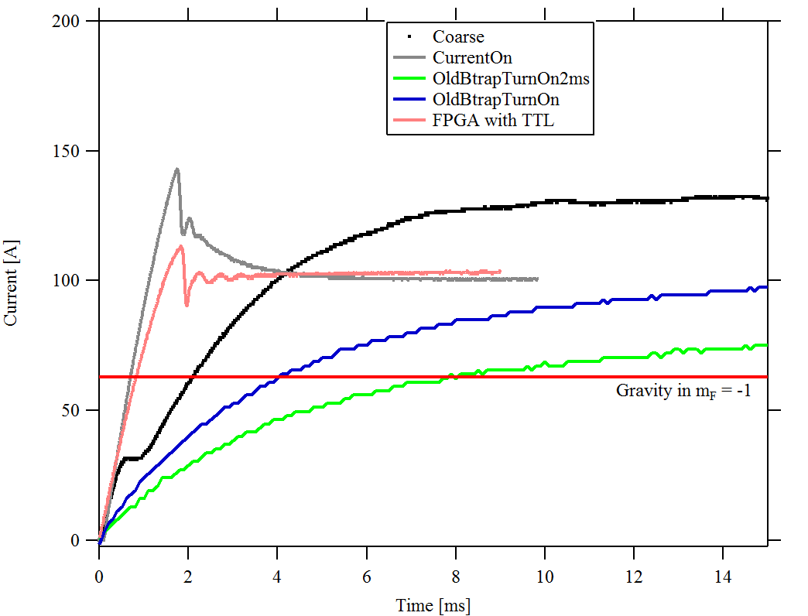
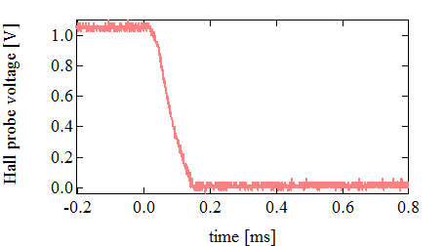
(a)
(b)

Slide 10
